Slide 1

BCA
Topic : Deadlocks
OPERATING SYSTEM
Module - 3
Unit - 1
A.Siddhartha
Asst. Professor

Slide 2



AIM
To familiarize students with the scheduling and different types of cpu scheduling algorithms
INSTRUCTIONAL OBJECTIVES
In this unit, the students will be able to:
Learn about the different types of schedulers and scheduling algorithms
LEARNING OUTCOMES
At the end of this unit, you should be able to:
Improvement of knowledge between different types of schedulers.
Deliberate various scheduling algorithms

Slide 3
SYSTEM MODEL
In system there are finite number of resources.
We will distribute these resources to different processes.
We will partition those resources in to several types.
Examples: Memory space,I/O devices
Process request the resource before using it.
It must release the resource after using it.
A process can request any number of resources.
But the thing is number of requested resourses should not be greater than available resources

Slide 4
Normal Mode:
Each process utilizes the resourse as follows:
Request: Process request resource
If it is not grant(using by some other process)it goes to wait for state.
Uses: IF it is available it uses that resources(it will operate on that resource)
Release: It will release the resource after using it.
Examples:
Request() & Release() ---- for device
Open() & Close() ----- for File
Allocate() & Free() ----- for Memory.

Slide 5
Deadlocks can occur when we are using same resource types or different resource types.
Same resource types:
If the system having 3 cd drives.
Consider that 3 processes holds one of these 3 drives.
If each process request another device then the 3 processes will be in deadlock state.

Slide 6
Different resource types:
If the system having printer, DVD drive.
If Pi holds printer, Pj holds DVD.
If Pi requests for DVD and Pj requests for printer then Deadlock will occur in this situation also.

Slide 7
DEADLOCKS
In multiprogramming several processes may compete for resources
If a process requests a resource and the resource is not available then the process will go to the waiting state.
Sometimes the state of the process could not change because the resources which are requested by that process are held by another process, and this situation is called a DEADLOCK state.

Slide 8
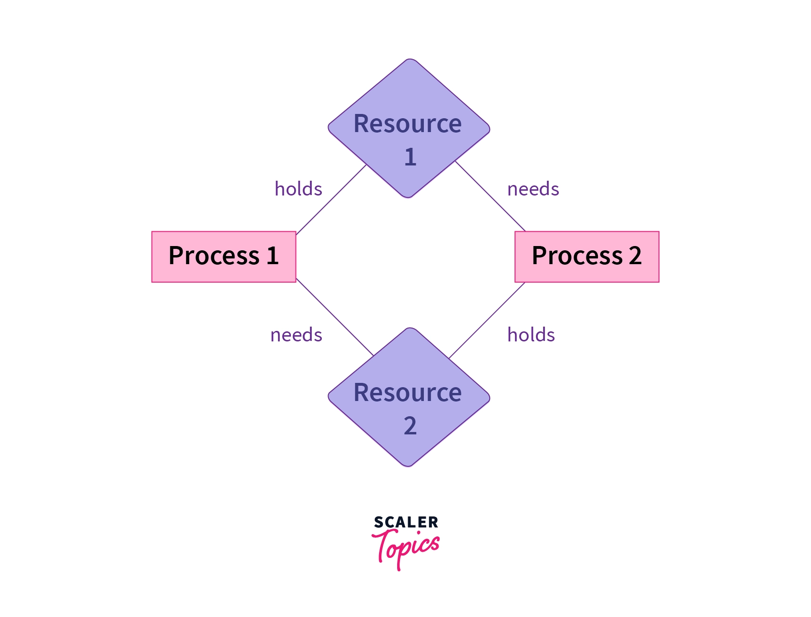

Slide 9
Necessary Conditions for Deadlock
The four necessary conditions for a deadlock to arise are as follows.
Mutual Exclusion: Only one process can use a resource at any given time i.e. the resources are non-sharable.
Hold and wait: A process is holding at least one resource at a time and is waiting to acquire other resources held by some other process.

Slide 10
No preemption: The resource can be released by a process voluntarily i.e. after execution of the process.
Circular Wait: A set of processes are waiting for each other in a circular fashion. For example, lets say there are a set of processes {P0​,P1​,P2​,P3​} such that P0​ depends on P1​, P1​ depends on P2​, P2​ depends on P3​ and P3​ depends on P0​. This creates a circular relation between all these processes and they have to wait forever to be executed.

Slide 11

Deadlock Handling-

Slide 12
Deadlock Prevention-
This strategy involves designing a system that violates one of the four necessary conditions required for the occurrence of deadlock.
This ensures that the system remains free from the deadlock.
The various conditions of deadlock occurrence may be violated as-

Slide 13
1. Mutual Exclusion-
To violate this condition, all the system resources must be such that they can be used in a shareable mode.
In a system, there are always some resources which are mutually exclusive by nature.
So, this condition can not be violated.

Slide 14
2. Hold and Wait
This condition can be violated in the following ways-
Approach-01:
In this approach,
A process has to first request for all the resources it requires for execution.
Once it has acquired all the resources, only then it can start its execution.
This approach ensures that the process does not hold some resources and wait for other resources.

Slide 15
Drawbacks-
The drawbacks of this approach are-
It is less efficient.
It is not implementable since it is not possible to predict in advance which resources will be required during execution.

Slide 16
Approach-02:
In this approach,
A process is allowed to acquire the resources it desires at the current moment.
After acquiring the resources, it start its execution.
Now before making any new request, it has to compulsorily release all the resources that it holds currently.
This approach is efficient and implementable.

Slide 17
Approach-03:
In this approach,
A timer is set after the process acquires any resource.
After the timer expires, a process has to compulsorily release the resource.

Slide 18
3. No Preemption-
This condition can by violated by forceful preemption.
Consider a process is holding some resources and request other resources that can not be immediately allocated to it.
Then, by forcefully preempting the currently held resources, the condition can be violated.

Slide 19
4. Circular Wait-
This condition can be violated by not allowing the processes to wait for resources in a cyclic manner.
To violate this condition, the following approach is followed-
Approach-
A natural number is assigned to every resource.
Each process is allowed to request for the resources either in only increasing or only decreasing order of the resource number.
In case increasing order is followed, if a process requires a lesser number resource, then it must release all the resources having larger number and vice versa.
This approach is the most practical approach and implementable.
However, this approach may cause starvation but will never lead to deadlock.

Slide 20
Deadlock Avoidance-
This strategy involves maintaining a set of data using which a decision is made whether to entertain the new request or not.
If entertaining the new request causes the system to move in an unsafe state, then it is discarded.
This strategy requires that every process declares its maximum requirement of each resource type in the beginning.
The main challenge with this approach is predicting the requirement of the processes before execution.
Banker’s Algorithm is an example of a deadlock avoidance strategy.

Slide 21
If there is single instance –resource allocation graph
Multiple instance-Bankers algorithm(safety algorithm, resource-request algorithm)

Slide 22
Banker’s Algorithm Example Solutions Exercise 1 Assume that there are 5 processes, P0 through P4, and 4 types of resources. At T0 we have the following system state: Max Instances of ReBanker’s Algorithm Example Solutions
Exercise 1
Assume that there are 5 processes, P0 through P4, and 4 types of resources. At T0 we have the
following system state:
Max Instances of Resource Type A = 3 (2 allocated + 1 Available)
Max Instances of Resource Type B = 17 (12 allocated + 5 Available)
Max Instances of Resource Type C = 16 (14 allocated + 2 Available)

Slide 23
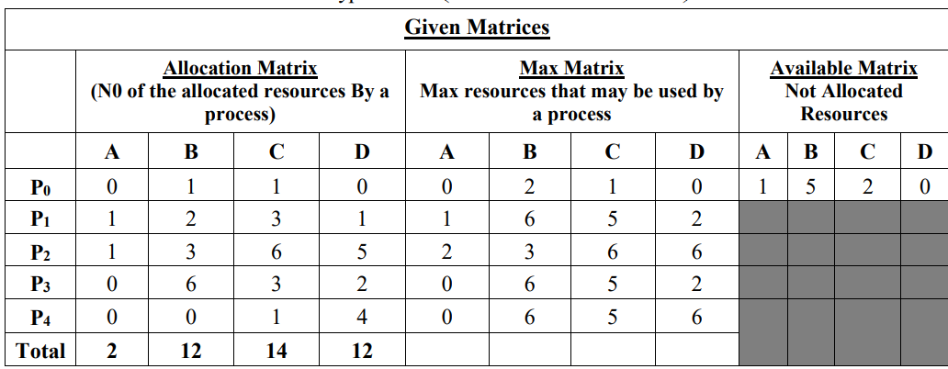

Slide 24
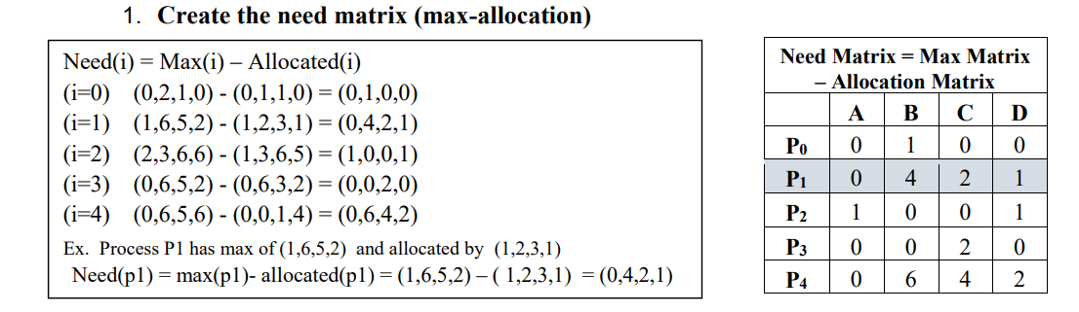

Slide 25
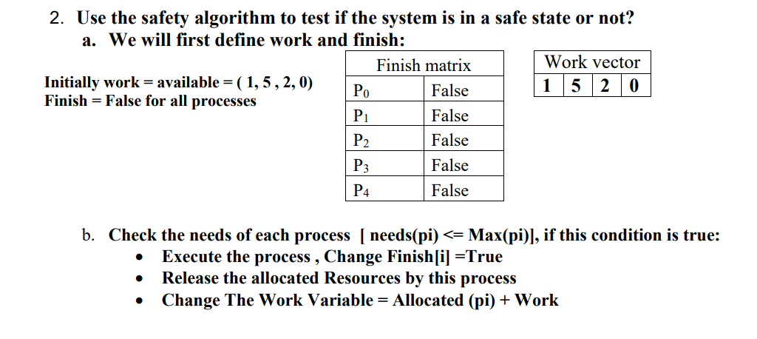

Slide 26
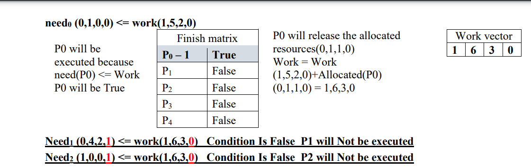

Slide 27
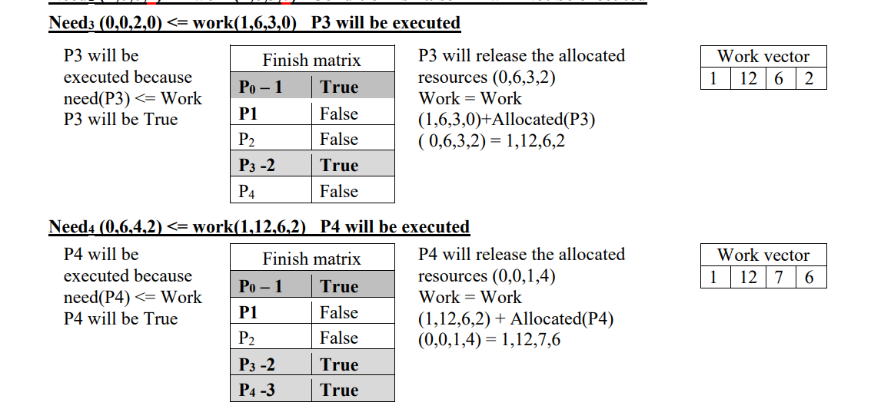

Slide 28
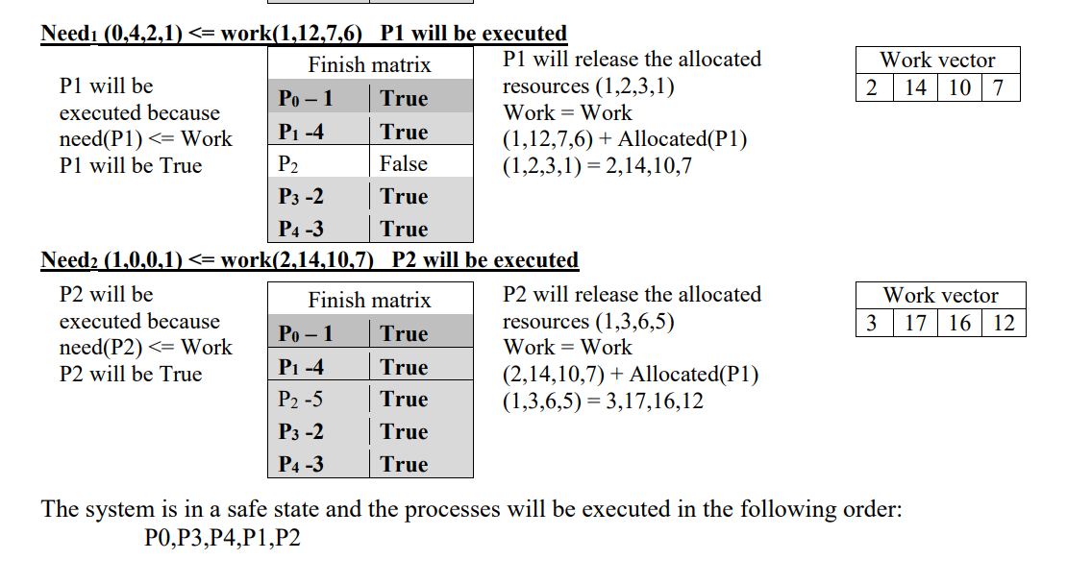

Slide 29
Deadlock Detection and Recovery-
This strategy involves waiting until a deadlock occurs.
After deadlock occurs, the system state is recovered.
The main challenge with this approach is detecting the deadlock.

Slide 30
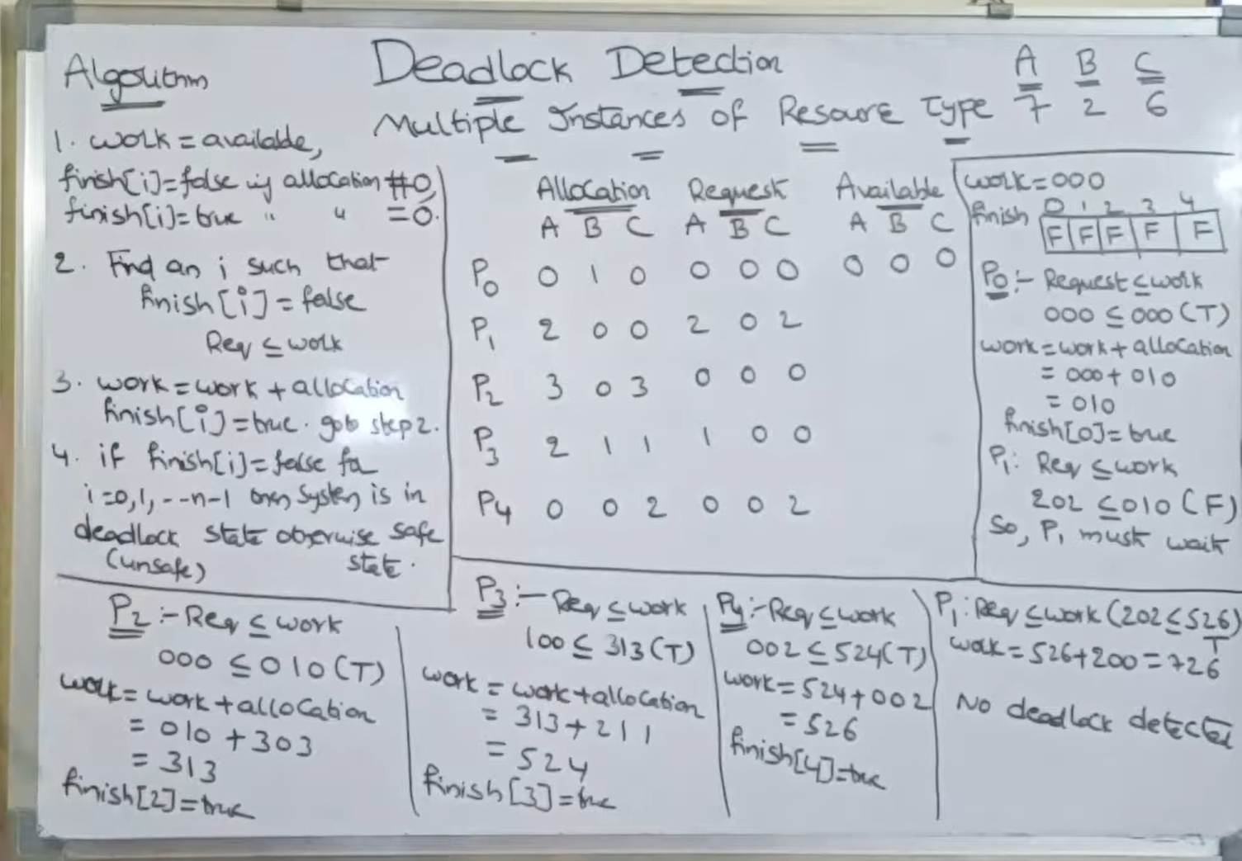

Slide 31
Deadlock Recovery
Killing the process: killing all the process involved in the deadlock. Killing process one by one. After killing each process check for deadlock again keep repeating the process till system recover from deadlock.
Resource Preemption: Resources are preempted from the processes involved in the deadlock, preempted resources are allocated to other processes so that there is a possibility of recovering the system from deadlock. In this case, the system goes into starvation.

Slide 32
SEMAPHORES

